Slide 1
Tissue Clearing
Josh Lawrimore, PhD

Slide 2
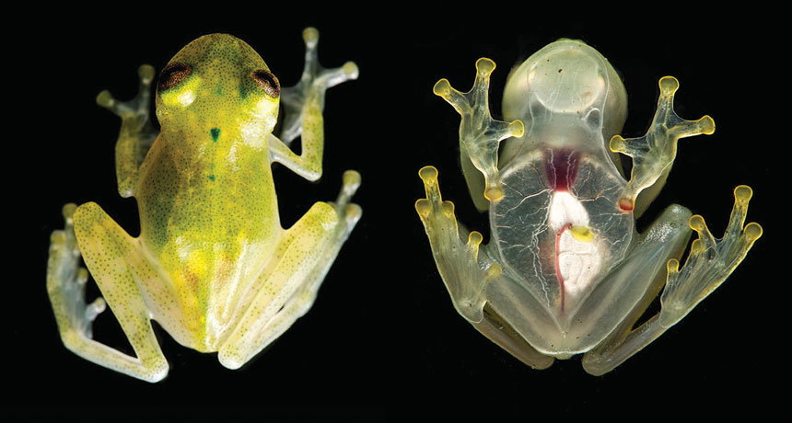
Microscopy: how does the light get in?
Subject is transparent already
Glass frogs can turn their skin transparent
Light doesn’t need to travel far
Thin tissue sections
Very small penetration into tissue
Make the sample transparent!
NOTHING TO HIDE A newly discovered glass frog (Hyalinobatrachium yaku, shown) has skin so transparent that its beating heart is visible.
J.M Guayasamin et al/ZooKeys 2017

Slide 3
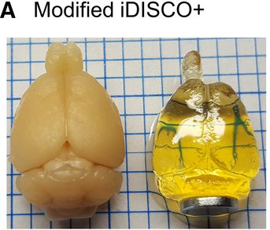
The Tissue Clearing Wars
Three methods debuted to turn ex-vivo tissue transparent
CLARITY
iDISCO
CUBIC
According to the creator of iDISCO, they mostly do the same thing and use different solvents
eNeuro 8 April 2022, 9 (3) ENEURO.0482-21.2022; https://doi.org/10.1523/ENEURO.0482-21.2022

Slide 4
So now that we’re clear…
iDISCO allows for about 1 cm of transparency
Can perform fluorescence microscopy using immunostaining
Fluorescence Microscopy
Shine in a specific wavelength of light
Out comes a lower, specific wavelength of light
Still need to worry about out of focus light
Luckily, there are modern techniques to only send light exactly where you want it
Multi-photon
Light Sheet

Slide 5
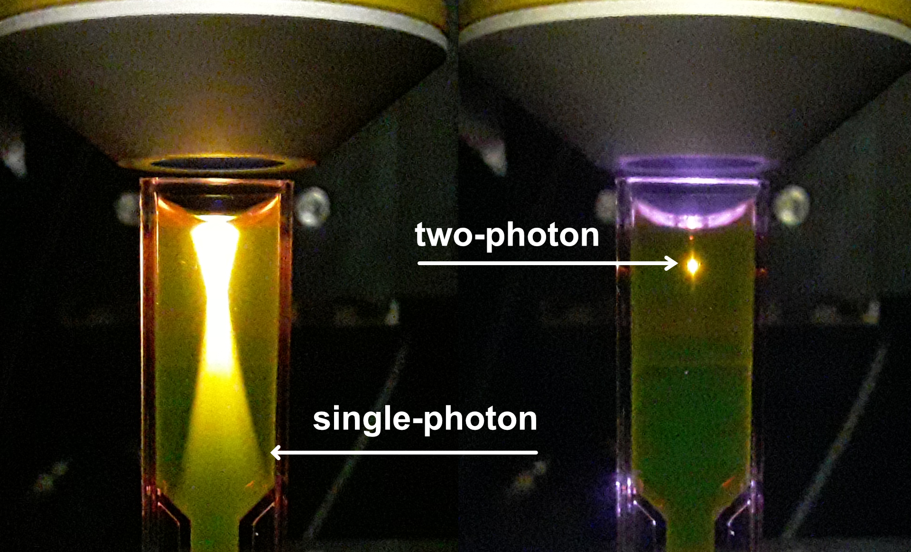
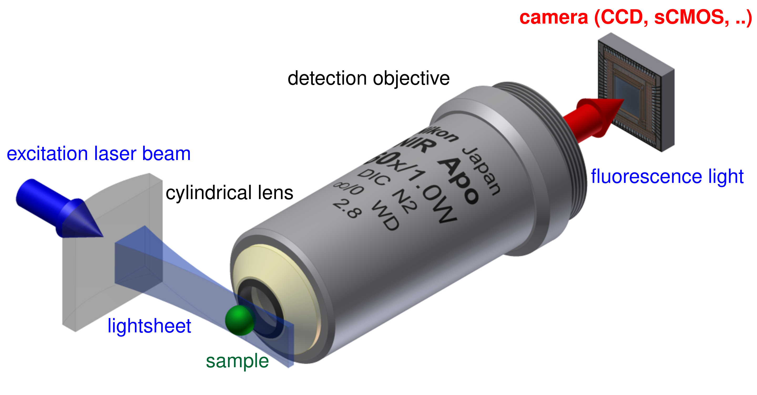
Some light physics
Multi-Photon
Light Sheet
https://bliqphotonics.com/what-is-two-photon-microscopy/
Shine in two or more low-energy photons near a fluorophore, get a single higher-energy photon out
Bend to light to only illuminate the focal plane of your sample
By Jan Krieger, CC BY-SA 3.0, https://commons.wikimedia.org/w/index.php?curid=22333698

Slide 6
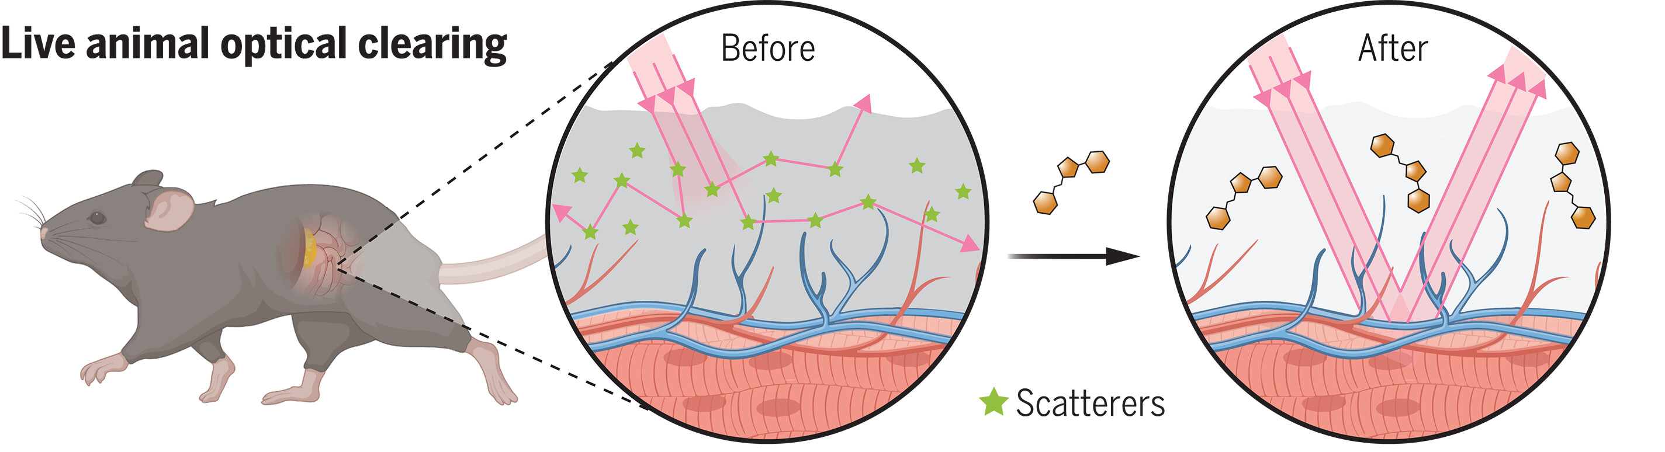
Why is skin opaque?
https://www.science.org/doi/10.1126/science.adm6869

